Slide 1
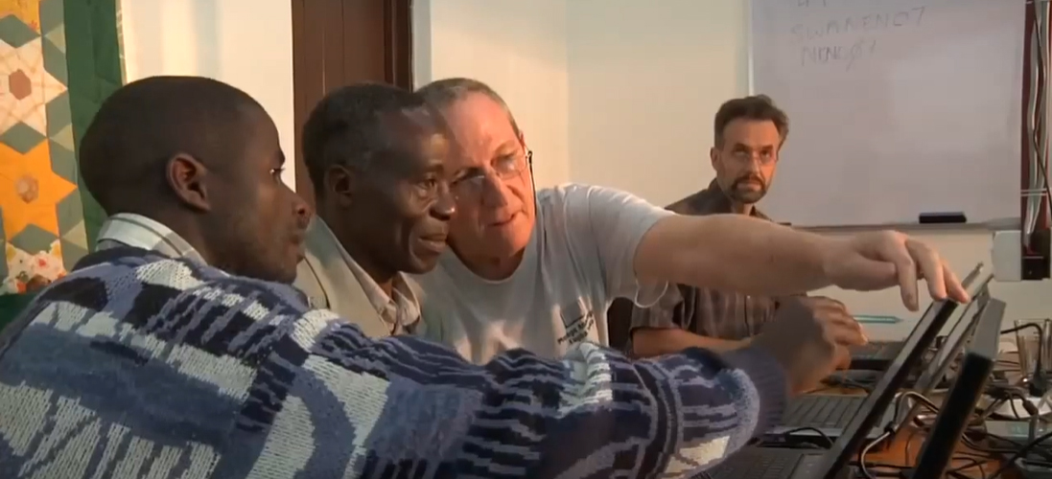
Translation Helps
Topic 8 – Session 1

Slide 2


Every Believer is Qualified

Slide 3
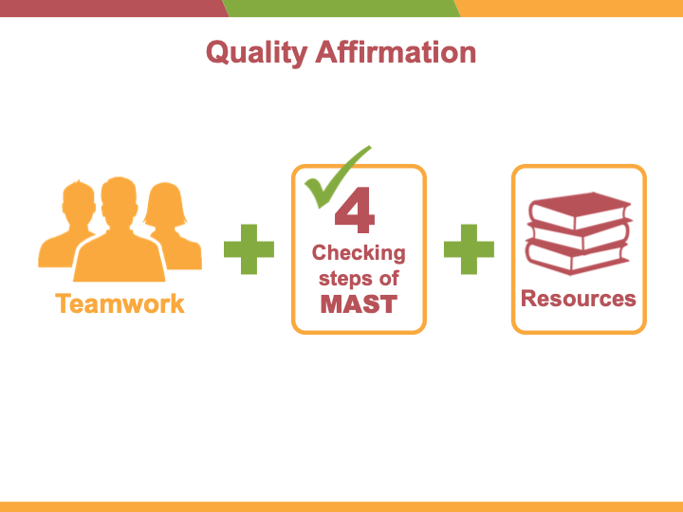


Quality Affirmation
4
Checking steps of MAST
Teamwork

Slide 4



Free Resources
https://bibleineverylanguage.org

Slide 5
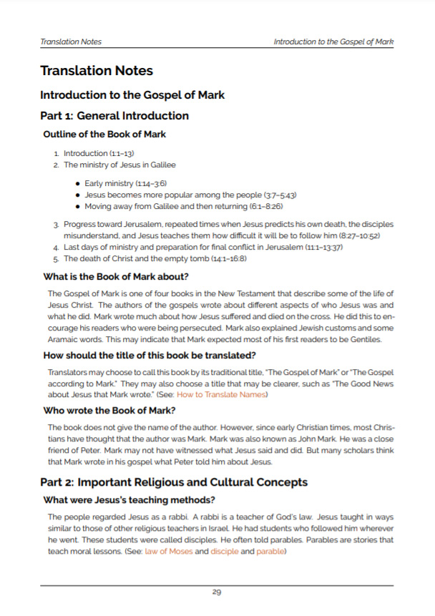
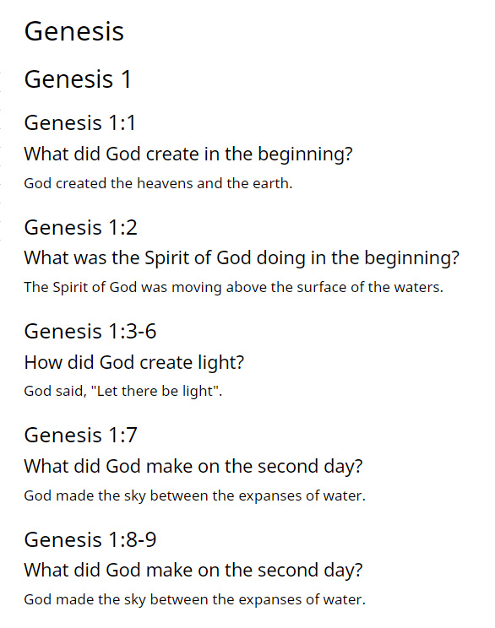
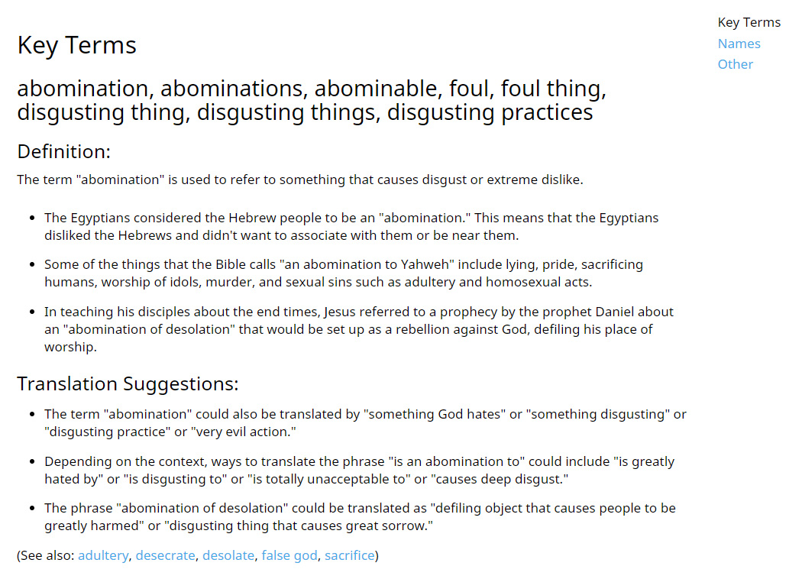
Translation Helps
For use with drafted passages
Translation Questions
Translation Notes
Translation Words

Slide 6

Use Resources to Check:
Your own work
A fellow translator's work
Keywords and names
Each verse
Each of the qualities on your Authentic Assessment

Slide 7
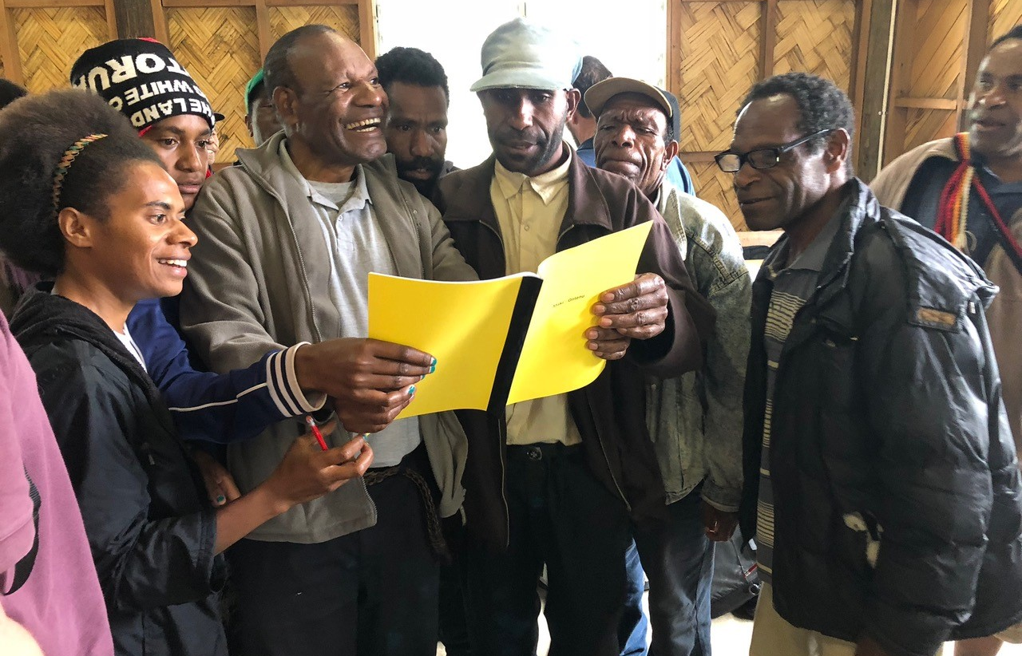
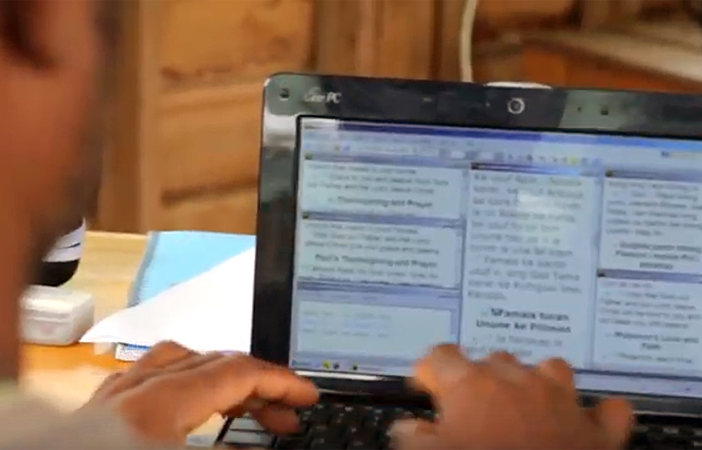
Upon MAST Completion:
Share
Refine

Slide 8
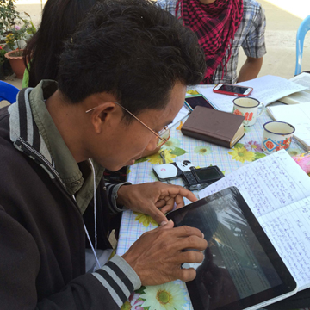
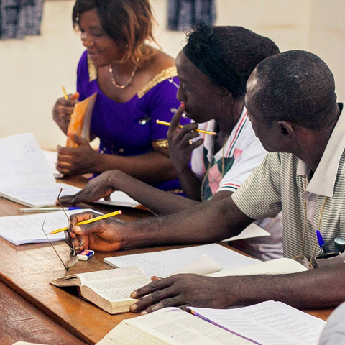
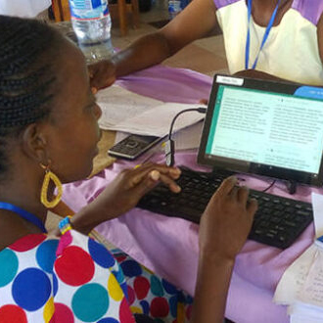


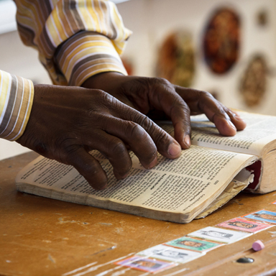


Translation Ownership
Need help? TS@WycliffeAssociates.org

Slide 9


